Slide 1
Security for Ad Hoc Networks
Jun Tao

Slide 2
Ad Hoc Networks
Ad hoc -- a Latin phrase which means
"for this [purpose]".
An autonomous system of mobile hosts
connected by wireless links, often called
Mobile Ad hoc NETworks (MANETs)

Slide 3
Characteristics
No fixed infrastructure
Dynamic changing topology
Mobile devices join/leave the network unexpectedly; they can also move freely
Energy-constrained
Limited bandwidth
Each node also serves as router
Help to relay packets received from neighbors
Interoperation with the Internet

Slide 4
Comparison
MANETs vs. Wired networks
In MANETs, each node also works as router for forwarding packets
In wired networks, routers perform routing task
MANETs vs. Managed wireless networks
No infrastructure in MANETs
Special node known as access point (AP) in managed wireless networks

Slide 5
A MANET Example

Slide 6
Mobile Devices
Laptop computers
Pagers, cellular phones, PDAs
In-car navigators -Dash Express
Dash units talk to each other and form a network that connects to the Internet
Traffic speed data is sent back to the company, then broadcast back to all local dash units
Sensors
……

Slide 7
Wireless Sensor Network (WSN)
An emerging application area for MANETs
A collection of cheap to manufacture, stationary, tiny sensors
Network lifetime -- power as a major driving issue
Battlefield surveillance, environment monitoring, health care, etc.

Slide 8
WSN Example

Slide 9
Other MANETs applications
Collaborative work
Crisis-management applications
Personal Area Networking (PAN)

Slide 10
Security Requirements in MANETs
Availability
Authorization and Key Management
Data Confidentiality
Data Integrity
Non-repudiation

Slide 11
Security Solution Constraints
Lightweight
Decentralized
Reactive
Fault-tolerant

Slide 12
Challenges
No infrastructure
Peer-to-peer architecture with multihop routing
Mobile device physical vulnerability
Stringent resource constraints
Wireless medium
Node mobility

Slide 13
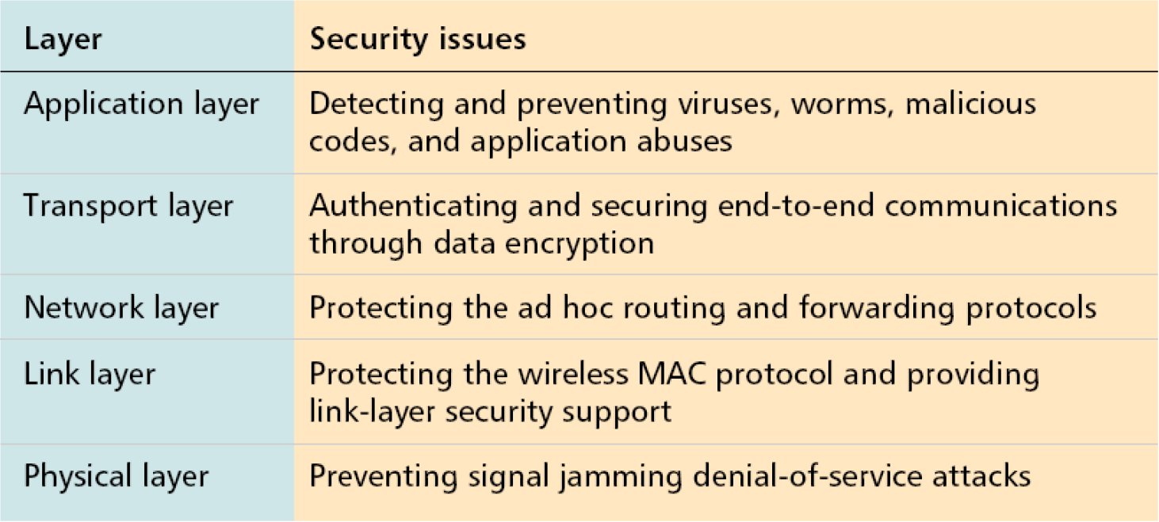
Security Issues

Slide 14
Threats
Attacks
External attacks
Internal attacks
Passive attacks
Active attacks
Misbehavior

Slide 15
MANETs Security
Routing security
Data forwarding security
Link layer security
Key management
Intrusion detection systems (IDSs)

Slide 16
Routing in MANETs
Nodes’ mobility -topology changes rapidly
Large network size -significant amount of network control traffic

Slide 17
MANET Routing Protocols
Topology-based approaches
Proactive routing (table driven)
Reactive routing (on demand)
Hybrid routing
Position-based approaches

Slide 18
Comparison
Proactive routing
Classic routing strategies: link state, distance vector
Keep track of routes to all possible destinations
Changes in link connection updated periodically
Minimal delay but substantial fraction of control information
E.g. DSDV, WRP, TBRPF, OLSR, etc.

Slide 19
Comparison
Reactive routing
Only discover routes to destinations ondemand
Consume much less bandwidth but experience substantial delay
E.g. DSR, ADOV, TORA, etc.

Slide 20
DSR vs. AODV
Dynamic source routing (DSR)
Source broadcasts RREQ through the network
Intermediate nodes add its addr to RREQ and continue broadcasting until RREP received
Full path chosen by source and put into each packet sent
Ad hoc on-demand distance vector (AOVD)
Hop-by-hop routing
Source sends RREQ to neighbors
Each neighbor does so until reach the destination
Destination node sends RREP follow the reverse path
Source doesn’t put whole path but only next hop addr in outgoing packets

Slide 21
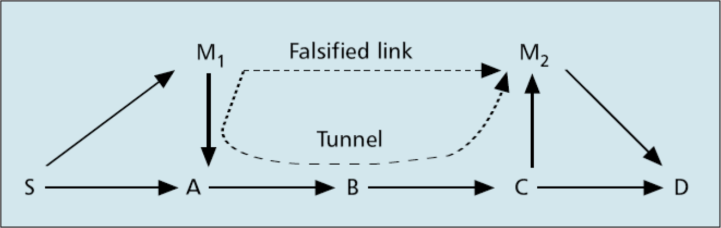
Routing Protocol Attacks
Attacks using modification
Redirection by modifying route sequence number
Redirection by modifying hop count
Source route modification
Tunneling

Slide 22
Routing Protocol Attacks
Attacks using fabrication
Falsifying route errors
Broadcast falsified routes
Spoofing attacks
Rushing attacks

Slide 23
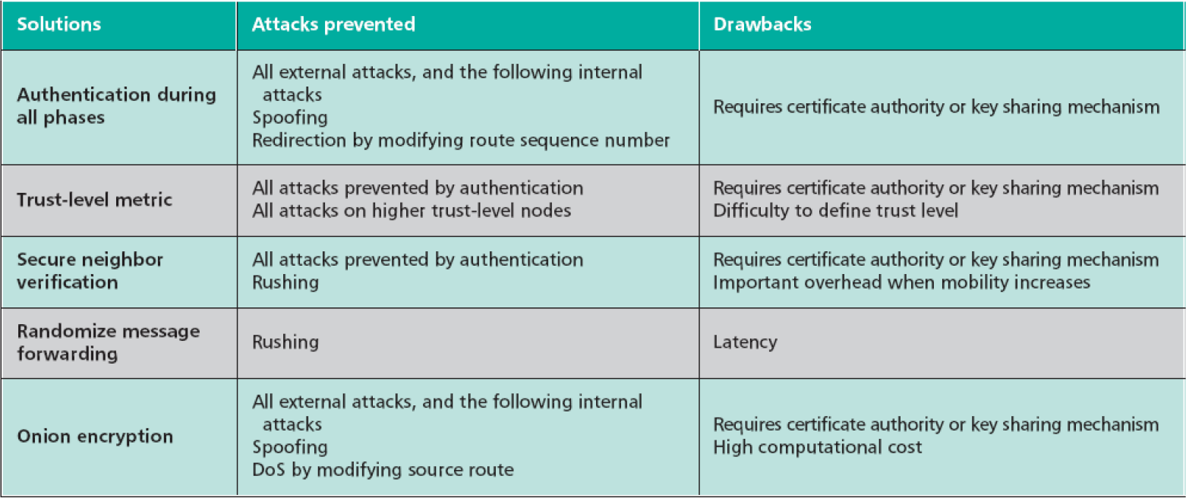
Solutions to Secure Routing Protocols

Slide 24
Data Forwarding Security
Threats
Eavesdropping (passive attacks)
cryptography can help to prevent but how to detect eavesdropping is still an open research topic
Dropping data packets (similar to selfishness)
Selfish behavior on data forwarding
Drops other nodes’ packets to preserve its resources, e.g. battery power

Slide 25
Detection Solution against Selfishness
End-to-end feedbacks
Monitoring in promiscuous mode (watchdog)
Activity-based overhearing
Mutually according admission in neighborhood
Reputation based solution
Probing

Slide 26
Preventive Solution against Selfishness
Nuglets
Nodes who use the service must pay for it to nodes that provide the service
Data dispersal
Adding redundancy to the messages to send; thus partial reception can lead to successful reconstruction of messages

Slide 27
Link Layer Security
IEEE 802.11 MAC
Vulnerable to DoS attacks
Attacks can exploit its binary exponential backoff scheme to launch DoS
A security extension to 802.11 was proposed
Backoff time at the sender is provided by the receiver
IEEE 802.11 WEP -discussed in wireless security

Slide 28
Key Management
Most of the solutions for secure routing and data forwarding rely on cryptography
Key management is problematic because of the lack of any central infrastructure
Private key infrastructure
Public key infrastructure

Slide 29
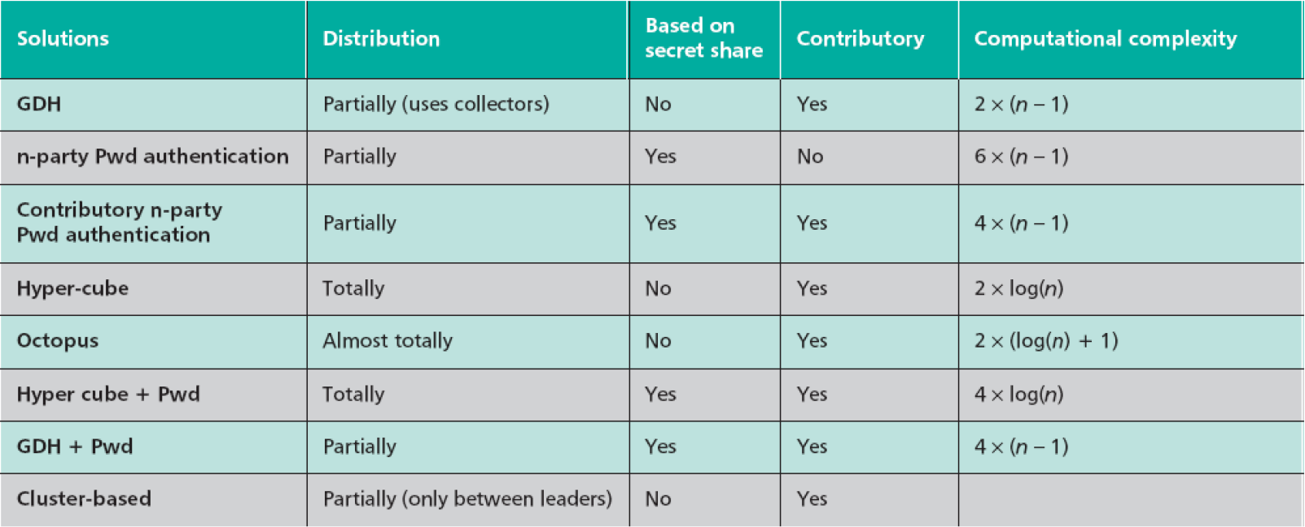
Private Key Infrastructure

Slide 30
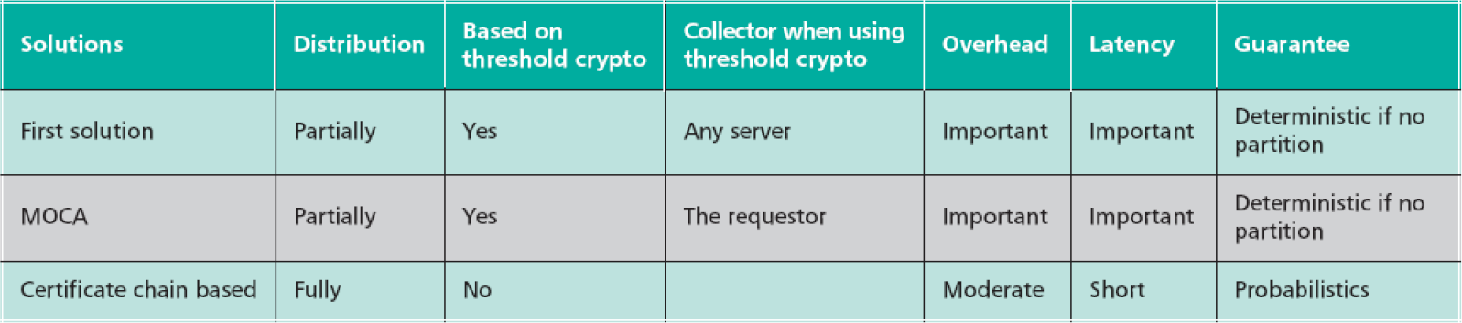
Public Key Infrastructure

Slide 31
Intrusion Detection Systems (IDSs)
Proactive solutions cannot eliminate attacks (secure routing layer, link layer mechanism)
IDS presents a second wall of defense
Assumptions
User and programs are observable
Normal and intrusion activities can be distinguished

Slide 32
Problems with Traditional IDSs in MANETs
Infrastructureless nature of MANETs
No traffic concentration points for monitoring
Resource limitation of mobile devices
Lack of clear separation between normalcy and anomaly
as nodes move around, the topology changes;
so each node should expect different traffic pattern from its neighbors

Slide 33
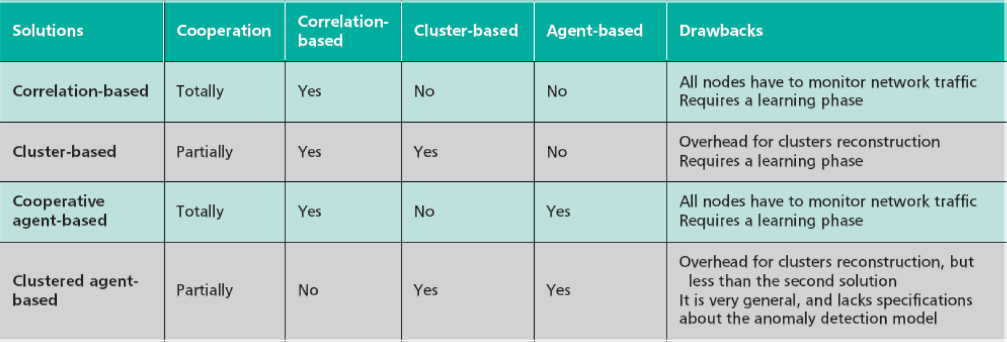
Proposed Solutions
Distributed, host-based, anomalybased, and cooperative

Slide 34
Wireless Sensor Network (WSN) Security
Consists of thousands or millions of tiny devices:
signal processing circuit,
micro-controller,
wireless transmitter/receiver,
embedded sensor

Slide 35
More Stringent Performance Requirement
More stringent performance requirement
Energy efficiency -network lifetime
Auto-organization
Scalability to a high number of nodes

Slide 36
Security Issues
Key distribution and management
Scalable to a large number of sensor nodes
Remains to be unsolved
Key pre-deployment
Shared key discovery
Path-key establishment
Alternatives
Probabilistic key sharing protocols

Slide 37
More Issues
Secure routing
Most routing protocols are quite simple in WSN, thus more vulnerable to attacks. Some new attacks are:
Sinkhole attacks
Hello flood attacks
Solutions
SPINS -two building block security protocols: SNEP and μTESLA
INSENS -intrusion-tolerant routing protocol

Slide 38
More Issues
Secure data aggregation
Key theme in design and development of WSNs
Aggregators collect raw data, process it locally, and forward only the result to end-user
Aggregation can take in any places, and must be secured
Denial of service
Jammed by adversaries: jam the entire network by broadcasting a high enough energy signal
Resilience to node capture

Slide 39
Summary
What we have discussed
Characteristics of MANETs, WSNs
Security issues in MANETs and WSNs
MANETs is a growth area of research; the security issues in MANETs attract a lot of researchers; we’ll be definitely seeing more of these problems in near future.

Slide 40
THANK YOU !

